Slide 1

Unit-1 Computer Data Representation & Register Transfer and Micro-operations
Computer System Architecture(CSA)
DU # 2101CS602
Prof. Vishal Kansagara
Computer Science & Engineering Department
Vishal.kansagara@darshan.ac.in
8200601076

Slide 2

Outline
Basic computer data types & Complements
Fixed point & Floating point representation
Register transfer language
Bus and Memory transfers (Three-State Bus Buffers, Memory Transfer)
Arithmetic Micro-operations
Logic Micro-operations
Shift Micro-operations
Arithmetic logical shift unit
Looping

Slide 3
Basic computer data types & Complements
Section - 1

Slide 4
Basic Computer Data Types & Complements
Basic Computer Data Types
Complements
Decimal Number System
Radix(r) = 10, Number range = 0 - 9
Binary Number System
Radix(r) = 2, Number range = 0 - 1
Octal Number System
Radix(r) = 8, Number range = 0 - 7
Hexadecimal Number System
Radix(r) = 16, Number range = 0 - 9 & A - F
Binary Coded Decimal Numbers
(r-1)’s complement
9’s complement
1’s complement
7’s complement
15’s complement
r’s complement
10’s complement
2’s complement
8’s complement
16’s complement

Slide 5
Fixed point & Floating point representation
Section - 2

Slide 6
Fixed point representation
Integer Representation
Signed-magnitude representation
1’s complement representation
2’s complement representation
Arithmetic Addition
Using 1’s complement
Using 2’s complement
Arithmetic Subtraction
Using 1’s complement
Using 2’s complement
Example: Represent (-14)
Signed-magnitude representation : 1 0001110
1’s complement representation : 1 1110001
2’s complement representation : 1 1110010
+ 6 | 00000110
+ 13 | 00001101
+ 19 | 00010011
+ 6 | 00000110
- 13 | 11110011
- 7 | 11111001
Note: negative number must initially be in 2’s complement

Slide 7
Floating point representation
Two parts
Mantissa – Represents signed fixed-point number
Exponent – Represents position of the decimal point
For example, the decimal number +6132.789 is represented in floating-point with a fraction and an exponent as follows:
The value of the exponent indicates that the actual position of the decimal point is four positions to the right of the indicated decimal point in the fraction.
Floating-point is always interpreted to represent a number in the following form: m X r^{e}
Here, m stands for mantissa, e stands for exponent, r means radix
Fraction
Exponent
+0.6132789
+04

Slide 8
Floating point representation
Normalization
A floating point number is said to be normalized if the most significant digit of the mantissa is nonzero.
For example, the decimal number 350 is normalized but 00035 is not.
ANSI 32-bit floating point byte format
S = Sign of Mantissa, E = Exponent bits, M = Mantissa bits
Example, 13 = 1101 = 0.1101 x 2⁴
= 00000100 .11010000 00000000 00000000
Example, -17 = - 10001 = -0.10001 x 2⁵
= 10000101 .10001000 00000000 00000000
Byte 1
Byte 2
Byte 3
Byte 4
SEEEEEEE
.MMMMMMMM
MMMMMMMM
MMMMMMMM

Slide 9
Floating point representation (IEEE 754)
IEEE 754 format
S = Sign of Mantissa, E = Exponent bits, M = Mantissa bits
Biased exponent is used (+127) to represent both tiny and huge values
Example, 85.125
85 = 1010101 and 0.125 = 001
85.125 = 1010101.001 = 1.010101001 x 2^6, sign = 0
biased exponent 127+6=133, 133 = 10000101
Normalised mantissa = 010101001 we will add 0's to complete the 23 bits
hence
Sign 1 bit
Exponent 8 bits
Mantissa 23 bits
0
10000101
01010100100000000000000

Slide 10
Register transfer language
Section - 3

Slide 11


Register
Computer Registers are designated by capital letters.
For example,
MAR – Memory Address Register
PC – Program Counter
IR – Instruction Register
R1 – Processor Register
$$R1$$
7 | 6 | 5 | 4 | 3 | 2 | 1 | 0
Register R
Showing individual bits
15
0
15
8
7
0
$$R2$$
PC (H) | PC (L)
Numbering of bits
Divided into two parts

Slide 12

Register Transfer Language
Information transfer from one register to another is designated in symbolic form by means of a replacement operator is known as Register Transfer.
The statement
denotes a transfer of the content of register 𝑅1 into register 𝑅2.
The symbolic notation used to describe the microoperation transfers among registers is called a register transfer language.
The term "register transfer" implies the availability of hardware logic circuits that can perform a stated microoperation and transfer the result of the operation to the same or another register.
A register transfer language is a system for expressing in symbolic form the microoperation sequences among the registers of a digital module.
$$R2←R1$$
R1
1 | 1 | 0 | 1
R2
1 | 1 | 0 | 1

Slide 13

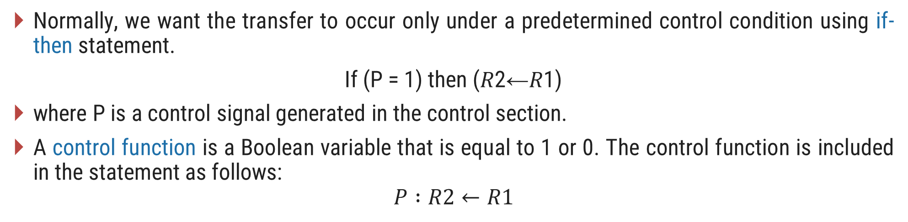

Register Transfer with Control Function
Normally, we want the transfer to occur only under a predetermined control condition using if-then statement.
If (P = 1) then (𝑅2←𝑅1)
where P is a control signal generated in the control section.
A control function is a Boolean variable that is equal to 1 or 0. The control function is included in the statement as follows:
$$P :R2←R1$$
t
t+1
P
Load
Clock
Control
circuit
$$R2$$
n
Load
$$R1$$
Transfer occurs here

Slide 14
Bus and Memory transfers
Section - 4

Slide 15
Common Bus System for 4 registers
A typical digital computer has many registers, and paths must be provided to transfer information from one register to another.
The number of wires will be excessive if separate lines are used between each register and all other registers in the system.
A more efficient scheme for transferring information between registers in a multiple-register configuration is a common bus system.
A bus structure consists of a set of common lines, one for each bit of a register, through which binary information is transferred one at a time.
One way of constructing a common bus system is with multiplexers.
The multiplexers select the source register whose binary information is then placed on the bus.
Register A
3 2 1 0
3 2 1 0
3 2 1 0
Register B
Register C

Slide 16
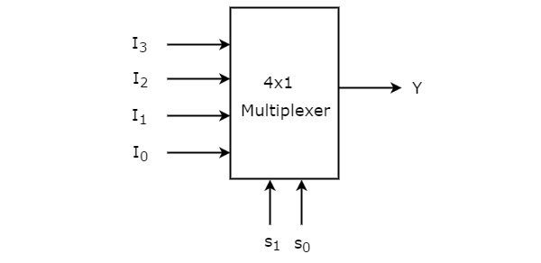
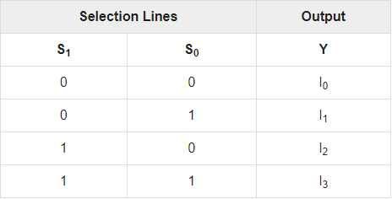
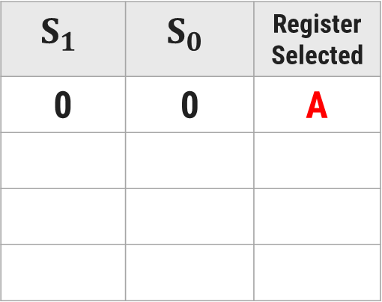
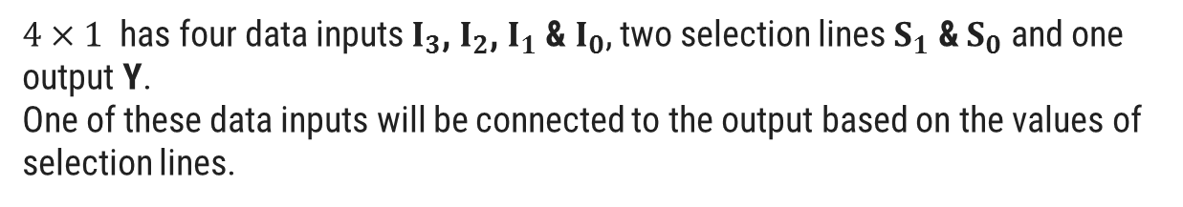
Bus System for 4 Registers using 4 Multiplexer
Four registers are connected through multiplexer to form one set of common BUS.
4-line common bus
First cell in each register is connected to one of the leftmost multiplexer, second cell to the second multiplexer and so on.
Each 4 × 1 multiplexer has two select lines (S_{1,} S₀).
A bus system is formed with 4 multiplexer circuits.
Each 4 × 1 multiplexer has one output line.
S₁
0
We also required 4 registers. Each register has four bits.
S₀
0
A₃
A₂
A₁
A₀
Truth Table:
4 x 1
MUX 3
4 x 1
MUX 2
4 x 1
MUX 1
4 x 1
MUX 0
$$S_{1}$$ | $$S_{0}$$ | Register Selected
0 | 0 | A
$4×1$ has four data inputs $I_{3}$, $I_{2}$, $I_{1}$ & $I_{0}$, two selection lines $S_{1}$ & $S_{0}$ and one output Y.
One of these data inputs will be connected to the output based on the values of selection lines.
3 2 1 0
3 2 1 0
3 2 1 0
3 2 1 0
D₂
C₂
B₂
A₂
D₁
C₁
B₁
A₁
D₀
C₀
B₀
A₀
D₂
D₁
D₀
C₂
C₁
C₀
B₂
B₁
B₀
A₂
A₁
A₀
3 2 1 0
3 2 1 0
3 2 1 0
3 2 1 0
Register D
Register C
Register B
Register A

Slide 17
Bus System for 4 Registers using 4 Multiplexer
4-line common bus
S₁
0
S₀
1
B₃
B₂
B₁
B₀
4 x 1
MUX 3
4 x 1
MUX 2
4 x 1
MUX 1
4 x 1
MUX 0
Truth Table:
$$S_{1}$$ | $$S_{0}$$ | Register Selected
0 | 0 | A
3 2 1 0
3 2 1 0
3 2 1 0
3 2 1 0
B
0
1
D₂
C₂
B₂
A₂
D₁
C₁
B₁
A₁
D₀
C₀
B₀
A₀
D₂
D₁
D₀
C₂
C₁
C₀
B₂
B₁
B₀
A₂
A₁
A₀
3 2 1 0
3 2 1 0
3 2 1 0
3 2 1 0
Register D
Register C
Register B
Register A

Slide 18
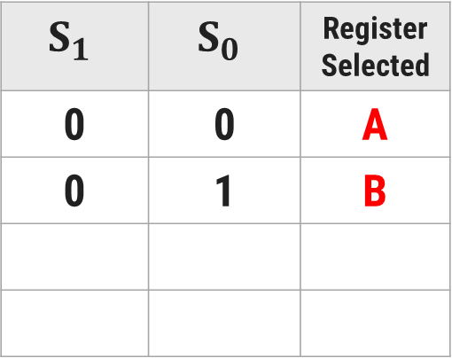
Bus System for 4 Registers using 4 Multiplexer
4-line common bus
S₁
1
S₀
0
C₃
C₂
C₁
C₀
Truth Table:
4 x 1
MUX 3
4 x 1
MUX 2
4 x 1
MUX 1
4 x 1
MUX 0
$$S_{1}$$ | $$S_{0}$$ | Register Selected
0 | 0 | A
0 | 1 | B
3 2 1 0
3 2 1 0
3 2 1 0
3 2 1 0
1
0
C
D₂
C₂
B₂
A₂
D₁
C₁
B₁
A₁
D₀
C₀
B₀
A₀
D₂
D₁
D₀
C₂
C₁
C₀
B₂
B₁
B₀
A₂
A₁
A₀
3 2 1 0
3 2 1 0
3 2 1 0
3 2 1 0
Register D
Register C
Register B
Register A

Slide 19
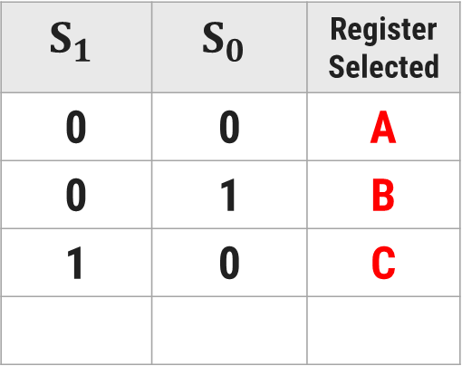
Bus System for 4 Registers using 4 Multiplexer
4-line common bus
S₁
1
S₀
1
D₃
D₂
D₁
D₀
4 x 1
MUX 3
4 x 1
MUX 2
4 x 1
MUX 1
4 x 1
MUX 0
Truth Table:
$$S_{1}$$ | $$S_{0}$$ | Register Selected
0 | 0 | A
0 | 1 | B
1 | 0 | C
3 2 1 0
3 2 1 0
3 2 1 0
3 2 1 0
D₂
C₂
B₂
A₂
D₁
C₁
B₁
A₁
D₀
C₀
B₀
A₀
1
1
D
D₂
D₁
D₀
C₂
C₁
C₀
B₂
B₁
B₀
A₂
A₁
A₀
3 2 1 0
3 2 1 0
3 2 1 0
3 2 1 0
Register D
Register C
Register B
Register A

Slide 20
Common Bus System for 4 registers
4-line common bus
0
S₁
S₀
0
A₃
A₂
A₁
A₀
4 x 1
MUX 3
4 x 1
MUX 2
4 x 1
MUX 1
4 x 1
MUX 0
3 2 1 0
3 2 1 0
3 2 1 0
3 2 1 0
D₂
C₂
B₂
A₂
D₁
C₁
B₁
A₁
D₀
C₀
B₀
A₀
D₂
D₁
D₀
C₂
C₁
C₀
B₂
B₁
B₀
A₂
A₁
A₀
3 2 1 0
3 2 1 0
3 2 1 0
3 2 1 0
Register D
Register C
Register B
Register A

Slide 21
Common Bus System for 4 registers
The construction of a bus system for four registers is explained earlier.
Each register has four bits, numbered 0 through 3.
The bus consists of four 4 x 1 multiplexers each having four data inputs, 0 through 3, and two selection inputs, S₁ and S₀.
The diagram shows that the bits in the same significant position in each register are connected to the data inputs of one multiplexer to form one line of the bus.
The two selection lines S₁ and S₀ are connected to the selection inputs of all four multiplexers.
The selection lines choose the four bits of one register and transfer them into the four-line common bus.
When S₁S₀ = 00, the 0 data inputs of all four multiplexers are selected and applied to the outputs that form the bus.
This causes the bus lines to receive the content of register A since the outputs of this register are connected to the 0 data inputs of the multiplexers.

Slide 22
Common Bus System for 4 registers
Table shows the register that is selected by the bus for each of the four possible binary values of the selection lines.
In general, a bus system will multiplex k registers of n bits each to produce an n-line common bus.
The number of multiplexers needed to construct the bus is equal to n, the number of bits in each register.
The size of each multiplexer must be k x 1 since it multiplexes k data lines.
For example, a common bus for eight registers of 16 bits requires
Multiplexers - 16 of (8 x 1)
Select Lines - 3
S₁ | S₀ | Register Selected
0 | 0 | A
0 | 1 | B
1 | 0 | C
1 | 1 | D

Slide 23
Tri-state Buffer (3 state Buffer)
A three-state gate is a digital circuit that exhibits three states.
Two of the states are signals equivalent to logic 1 and 0 as in a conventional gate.
The third state is high impedance state which behaves like an open circuit, which means that the output is disconnected and does not have logic significance.
The control input determines the output state. When the control input C is equal to 1, the output is enabled and the gate behaves like any conventional buffer, with the output equal to the normal input.
When the control input C is 0, the output is disabled and the gate goes to a high-impedance state, regardless of the value in the normal input.
Normal Input A
Output Y = A if C =1
High-impedance if C = 0
Control Input C

Slide 24
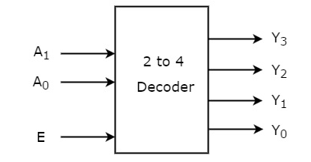
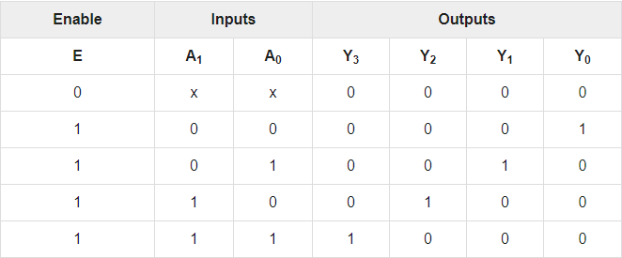
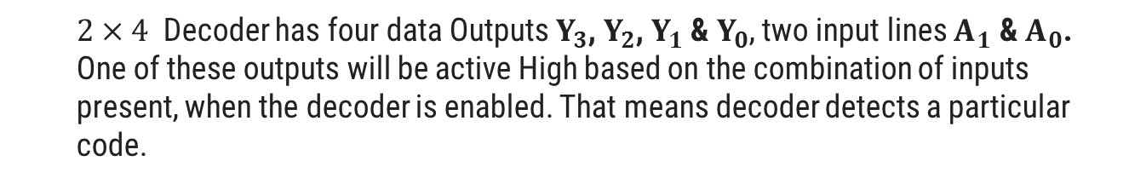
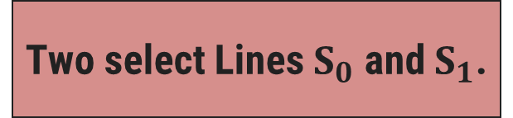
Bus System with three state buffer and decoder (Conti…)
We required one 2 x 4
Decoder.
The outputs of four buffers are connected together to form a single bus line.
Bus line for bit 0
The control inputs to the buffers determine which of the four normal inputs will communicate with the bus line.
We required 4 Buffers.
Two select Lines $S_{0}$ and $S_{1}$.
A₀
One Enable Line E.
$2×4$ Decoder has four data Outputs $Y_{3}$, $Y_{2}$, $Y_{1}$ & $Y_{0}$, two input lines $A_{1}$ & $A_{0}$.
One of these outputs will be active High based on the combination of inputs present, when the decoder is enabled. That means decoder detects a particular code.
B₀
C₀
D₀
2 x 4
Decoder
0
1
2
3
S₁
S₀
E
Select
Enable

Slide 25
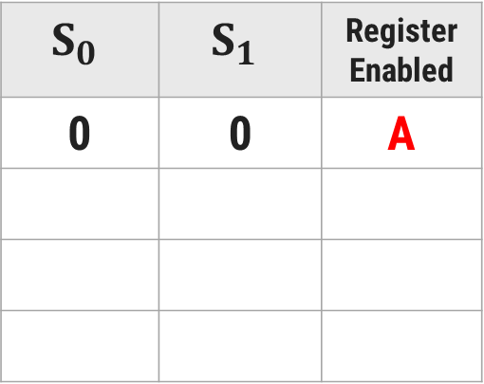
Bus System with three state buffer and decoder (Conti…)
Bus line for bit 0
A₀
Truth Table:
B₀
$$S_{0}$$ | $$S_{1}$$ | Register Enabled
0 | 0 | A
C₀
D₀
2 x 4
Decoder
0
0
1
2
3
S₁
S₀
E
Select
0
Enable

Slide 26
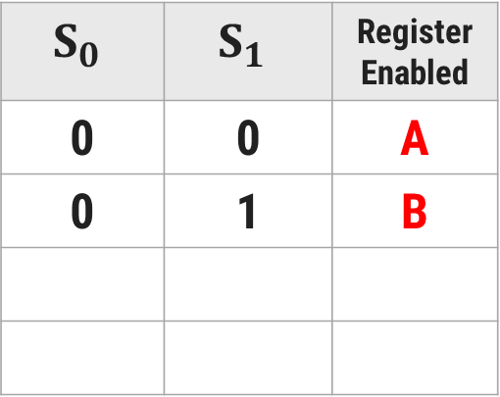
Bus System with three state buffer and decoder (Conti…)
Bus line for bit 0
A₀
Truth Table:
B₀
$$S_{0}$$ | $$S_{1}$$ | Register Enabled
0 | 0 | A
0 | 1 | B
C₀
D₀
2 x 4
Decoder
1
0
1
2
3
S₁
S₀
E
Select
0
Enable

Slide 27
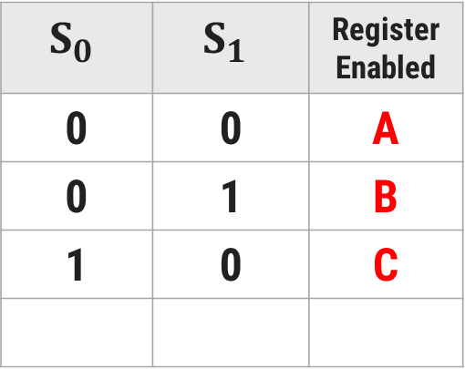
Bus System with three state buffer and decoder (Conti…)
Bus line for bit 0
A₀
Truth Table:
B₀
$$S_{0}$$ | $$S_{1}$$ | Register Enabled
0 | 0 | A
0 | 1 | B
1 | 0 | C
C₀
D₀
2 x 4
Decoder
0
0
1
2
3
S₁
S₀
E
Select
1
Enable

Slide 28
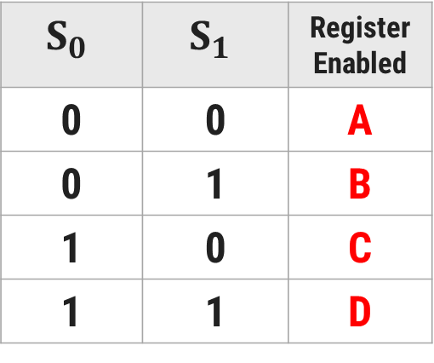
Bus System with three state buffer and decoder (Conti…)
Bus line for bit 0
A₀
Truth Table:
B₀
$$S_{0}$$ | $$S_{1}$$ | Register Enabled
0 | 0 | A
0 | 1 | B
1 | 0 | C
1 | 1 | D
C₀
D₀
2 x 4
Decoder
1
0
1
2
3
S₁
S₀
E
Select
1
Enable

Slide 29
Common Bus System using Decoder and Tri-state Buffer
The construction of a bus system with three-state buffers is demonstrated in previous figure.
The outputs of four buffers are connected together to form a single bus line.
The control inputs to the buffers determine which of the four normal inputs will communicate with the bus line.
The connected buffers must be controlled so that only one three-state buffer has access to the bus line while all other buffers are maintained in a high impedance state.
One way to ensure that no more than one control input is active at any given time is to use a decoder, as shown in the figure: Bus line with three state-buffers.
When the enable input of the decoder is 0, all of its four outputs are 0, and the bus line is in a high-impedance state because all four buffers are disabled.
When the enable input is active, one of the three-state buffers will be active, depending on the binary value in the select inputs of the decoder.

Slide 30
Arithmetic Micro-operations
Section - 5

Slide 31
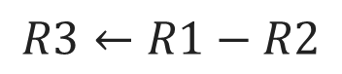
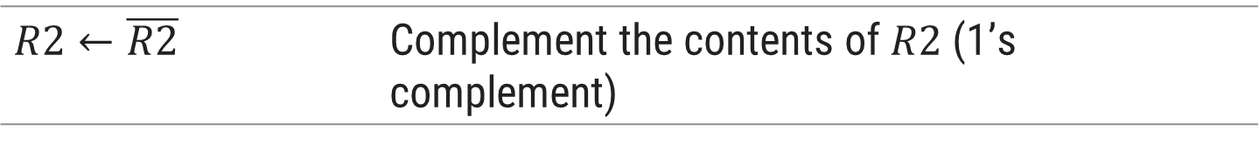
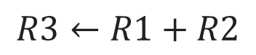
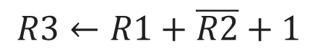
Arithmetic Microoperations
Arithmetic microoperations perform arithmetic operations on numeric data stored in registers.
Symbolic Designation | Description
Add Microoperation
$$R3←R1+R2$$ | Contents of $R1$ plus $R2$ transferred to $R3$
$$R3←R1+R2$$
$$R3←R1−R2$$ | Contents of $R1$ minus $R2$ transferred to $R3$
$$R2←\overline{R2}$$ | Complement the contents of $R2$ (1’s complement)
Subtract Microoperation
$$R2←\overline{R2}+1$$ | 2’s complement the contents of $R2$ (negate)
$$R3←R1−R2$$
$$R3←R1+\overline{R2}+1$$ | $R1$ plus the 2’s complement of $R2$ (subtraction)
$$R3←R1+\overline{R2}+1$$
$$R1←R1+1$$ | Increment the content of $R1$ by one
$$R1←R1−1$$ | Decrement the content of $R1$ by one

Slide 32
4-bit Binary Adder
The digital circuit that generates the arithmetic sum of two binary numbers of any length is called a binary adder.
Example
0
1
1
1
1
0
1
1
B₃
A₃
B₂
A₂
B₁
A₁
B₀
A₀
1
1
1
0
C
1
1
1
0
FA
C₃
FA
C₂
FA
C₁
FA
C₀
R1
1
1
0
1
A
R2
+
0
1
1
1
B
Sum
1
0
1
0
0
C₄
S₃
S₂
S₁
S₀
1
0
1
0
0

Slide 33
The binary adder is constructed with full-adder circuits connected in cascade, with the output carry from one full-adder connected to the input carry of the next full-adder.
The figure shows the interconnections of four full-adders (FA) to provide a 4-bit binary adder.
The augends bits of A and the addend bits of B are designated by subscript numbers from right to left, with subscript 0 denoting the low-order bit.
The carries are connected in a chain through the full-adders.
The input carry to the binary adder is C0 and the output carry is C4.
The S outputs of the full-adders generate the required sum bits.
An n-bit binary adder requires n full-adders.
The output carry from each full-adder is connected to the input carry of the next-high-order full-adder.
The n data bits for the A inputs come from one register (such as R1), and the n data bits for the B inputs come from another register (such as R2). The sum can be transferred to a third register or to one of the source registers (R1 or R2), replacing its previous content.

Slide 34
4-bit Binary Adder-Subtractor
when M = 0 the circuit is an Adder
when M = 1 the circuit becomes a Subtractor
When M = 0, we have
C₀ = 0 & B ⊕ 0 = B
When M = 1, we have
C₀ = 1 & B ⊕ 1 = B’
B₃
A₃
B₂
A₂
B₁
A₁
B₀
A₀
1
0
1
0
1
0
1
0
1
0
M
B₃’
B₃
B₂’
B₂
B₁’
B₁
B₀’
B₀
FA
C₃
FA
C₂
FA
C₁
FA
C₀
C₄
S₃
S₂
S₁
S₀

Slide 35
4-bit Binary Incrementer
The increment microoperation adds one to a number in a register.
1
1
0
1
A₃
A₂
A₁
A₀
1
0
0
1
x
y
x
y
x
y
x
y
C
0
0
1
R1
1
1
0
1
HA
HA
HA
HA
+
1
Sum
1
1
1
0
C
S
C
S
C
S
C
S
C₄
S₃
S₂
S₁
S₀
0
1
1
1
0

Slide 36
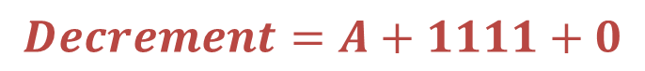
4-bit Arithmetic Circuit
The arithmetic micro operations can be implemented in one composite arithmetic circuit.
The basic component of an arithmetic circuit is the parallel adder.
By controlling the data inputs to the adder, it is possible to obtain different types of arithmetic operations.
The output of binary adder is calculated from arithmetic sum.
𝑫=𝑨+𝒀+𝑪_{𝒊𝒏}
Decrement using 2’s complement
1
1
1
1
1
0
1
1
1
0
1
-
1
2’s complement
+
1
1
1
1
$$Decrement=A+1111+0$$
1
1
0
0
1
1
1
0
0
Discard carry

Slide 37
4-bit Arithmetic Circuit
Decremented content of A
D₀
D₁
D₂
D₃
C_{out}
0
C₀
C₁
C₁
C₂
C₂
C₃
C₃
C₄
FA
FA
FA
FA
X₀
Y₀
X₁
Y₁
X₂
Y₂
X₃
Y₃
1
1
1
1
4 x 1
MUX
4 x 1
MUX
4 x 1
MUX
4 x 1
MUX
S₁ S₀ 0 1 2 3
S₁ S₀ 0 1 2 3
S₁ S₀ 0 1 2 3
S₁ S₀ 0 1 2 3
1
0
0
C_{in}
A₀
B₀
A₁
B₁
A₂
B₂
A₃
B₃
S₁
S₀
1
1

Slide 38
4-bit Arithmetic Circuit
Hardware implementation consists of:
4 full-adder circuits that constitute the 4-bit adder and four multiplexers for choosing different operations.
There are two 4-bit inputs A and B.
The four inputs from A go directly to the X inputs of the binary adder. Each of the four inputs from B is connected to the data inputs of the multiplexers. The multiplexer’s data inputs also receive the complement of B.
The other two data inputs are connected to logic-0 and logic-1.
Logic-0 is a fixed voltage value (0 volts for TTL integrated circuits)
Logic-1 signal can be generated through an inverter whose input is 0.
The four multiplexers are controlled by two selection inputs, S₁ and S₀.
The input carry C_{in} goes to the carry input of the FA in the least significant position. The other carries are connected from one stage to the next.
4-bit output D₀…D₃

Slide 39
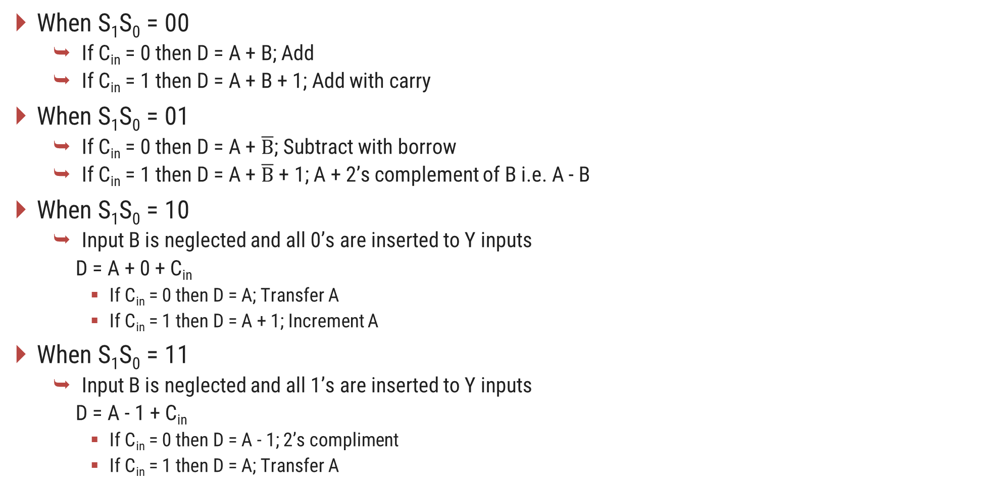
4-bit Arithmetic Circuit
When S₁S₀ = 00
If C_{in} = 0 then D = A + B; Add
If C_{in} = 1 then D = A + B + 1; Add with carry
When S₁S₀ = 01
If C_{in} = 0 then D = A + $\overline{B}$; Subtract with borrow
If C_{in} = 1 then D = A + $\overline{B}$ + 1; A + 2’s complement of B i.e. A - B
When S₁S₀ = 10
Input B is neglected and all 0’s are inserted to Y inputs
D = A + 0 + C_{in}
If C_{in} = 0 then D = A; Transfer A
If C_{in} = 1 then D = A + 1; Increment A
When S₁S₀ = 11
Input B is neglected and all 1’s are inserted to Y inputs
D = A - 1 + C_{in}
If C_{in} = 0 then D = A - 1; 2’s compliment
If C_{in} = 1 then D = A; Transfer A

Slide 40
4-bit Arithmetic Circuit
Arithmetic Circuit Function
S₁ | S₀ | C_{in} | Y | D = A + Y + C_{in} | Microoperation
0 | 0 | 0 | B | D = A + B | Add
0 | 0 | 1 | B | D = A + B + 1 | Add with carry
0 | 1 | 0 | B’ | D = A + B’ | Subtract with borrow
0 | 1 | 1 | B’ | D = A + B’ + 1 | Subtract
1 | 0 | 0 | 0 | D = A | Transfer
1 | 0 | 1 | 0 | D = A + 1 | Increment A
1 | 1 | 0 | 1 | D = A – 1 | Decrement A
1 | 1 | 1 | 1 | D = A | Transfer A

Slide 41
Logic Micro-operations
Section - 6

Slide 42


Logic Microoperations
Logic micro operations specify binary operations for strings of bits stored in registers.
These operations consider each bit of the register separately and treat them as binary variables.
Example
$$P: R1←R1 ⨁ R2$$
R1
1
0
1
0
R2
$$⨁$$
1
1
0
0
R1 after P = 1
0
1
1
0

Slide 43
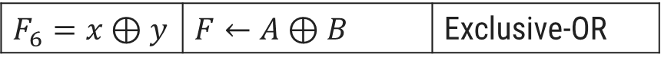
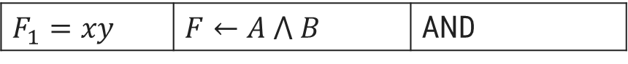
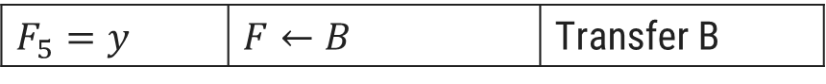
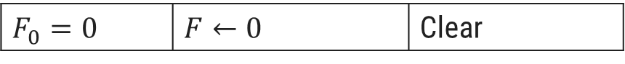
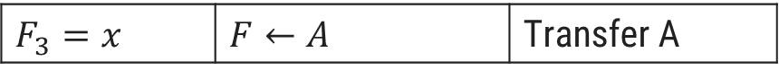
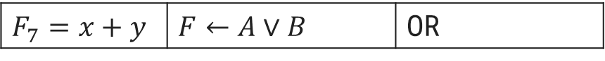
Logic Microoperations
Boolean Function | Microoperation | Name
Boolean Function | Microoperation | Name
$$F_{8}=(x+y)′$$ | $$F←\overline{A∨B}$$ | NOR
$$F_{0}=0$$ | $$F←0$$ | Clear
$$F_{9}=(x⊕y)′$$ | $$F←\overline{A⊕B}$$ | Exclusive-NOR
$$F_{1}=xy$$ | $$F←A ⋀ B$$ | AND
$$F_{10}=y′$$ | $$F←\overline{B}$$ | Complement B
$$F_{2}=xy′$$ | $$F←A ⋀ \overline{B}$$
$$F_{3}=x$$ | $$F←A$$ | Transfer A
$$F_{11}=x+y′$$ | $$F←A∨\overline{B}$$
$$F_{4}=x′y$$ | $$F←\overline{A} ⋀ B$$
$$F_{12}=x′$$ | $$F←\overline{A}$$ | Complement A
$$F_{5}=y$$ | $$F←B$$ | Transfer B
$$F_{13}=x′+y$$ | $$F←\overline{A}∨B$$
$$F_{6}=x⊕y$$ | $$F←A⊕B$$ | Exclusive-OR
$$F_{14}=(xy)′$$ | $$F←\overline{A∧B}$$ | NAND
$$F_{7}=x+y$$ | $$F←A∨B$$ | OR
$$F_{15}=1$$ | $$F←all 1^{′}s$$ | Set to all 1’s

Slide 44
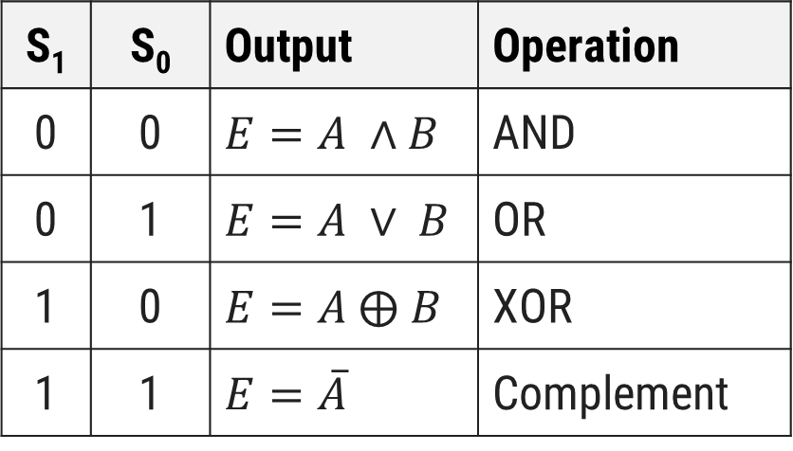
Hardware Implementation of Logic Circuit
S₁
4 x 1
MUX
S₀
S₁ | S₀ | Output | Operation
0 | 0 | $$E=A ∧B$$ | AND
0 | 1 | $$E=A ∨ B$$ | OR
1 | 0 | $$E=A ⨁ B$$ | XOR
1 | 1 | $$E=\overline{A}$$ | Complement
A_{i}
B_{i}
0
1
2
3
E_{i}

Slide 45
Applications of Logic Microoperations
Selective Set Operation
The selective-set operation sets to 1 the bits in register A where there are corresponding 1's in register B.
It does not affect bit positions that have 0's in B.
The OR microoperation can be used to selectively set bits of a register.
1
0
1
0
A before
1
1
0
0
B (logic operand)
1
1
1
0
A after

Slide 46
Applications of Logic Microoperations
Selective Complement Operation
The selective-complement operation complements bits in register A where there are corresponding 1's in register B.
It does not affect bit positions that have 0's in B.
The exclusive - OR microoperation can be used to selectively set bits of a register.
1
0
1
0
A before
1
1
0
0
B (logic operand)
0
1
1
0
A after

Slide 47
Applications of Logic Microoperations
Selective Clear Operation
The selective-clear operation clears to 0 the bits in register A only where there are corresponding 1's in register B.
It does not affect bit positions that have 0's in B.
The corresponding logic microoperation is A ← A ∧ B’.
1
0
1
0
A before
1
1
0
0
B (logic operand)
0
0
1
0
A after

Slide 48
Applications of Logic Microoperations
Mask Operation
The mask operation is similar to the selective-clear operation except that the bits of register A are cleared only where there are corresponding 0’s in register B.
The mask operation is an AND microoperation.
1
0
1
0
A before
1
1
0
0
B (logic operand)
1
0
0
0
A after

Slide 49
Applications of Logic Microoperations
Insert Operation
The insert operation inserts a new value into a group of bits.
This is done by first masking and then ORing them with required value.
The mask operation is an AND microoperation and the insert operation is an OR microoperation.
Mask
Insert
A
0
1
1
0
1
0
1
0
A
0
0
0
0
1
0
1
0
B
0
0
0
0
1
1
1
1
B
1
0
0
1
0
0
0
0
A
0
0
0
0
1
0
1
0
A
1
0
0
1
1
0
1
0

Slide 50
Applications of Logic Microoperations
Clear Operation
The clear operation compares the words in register A and register B and produces an all 0’s result if the two numbers are equal.
This operation is achieved by an exclusive-OR microoperation.
1
0
1
0
A
1
0
1
0
B
0
0
0
0
A ← A ⊕ B

Slide 51
Shift Micro-operations
Section - 7

Slide 52
Shift Microoperations
Shift microoperations are used for serial transfer of data.
Used in conjunction with arithmetic, logic and other data processing operations.
The content of the register can be shifted to the left or the right.
The first flip-flop receives its binary information from the serial input.
The information transferred through the serial input determines the type of shift.
Types of Shift
Logical
Circular
Arithmetic

Slide 53
Types of Shift
Logical Shift
A logical shift is one that transfers 0 through the serial input.
shl - logical shift left
shr - logical shift right
R1
1 | 1 | 0 | 1
R1
1 | 1 | 0 | 1
R1
1
0
1
0
R1
0
1
1
0

Slide 54
Types of Shift
Circular Shift
A circular shift (also known as a rotate operation) circulates the bits of the register around the two ends without loss of information.
This is accomplished by connecting the serial output of the shift register to its serial input.
cil - circular shift left
cir - circular shift right
R1
1 | 1 | 0 | 1
R1
1 | 1 | 0 | 1
R1
1
0
1
1
R1
1
1
1
0

Slide 55
Types of Shift
Arithmetic Shift
An arithmetic shift is a micro-operation that shifts a signed binary number to the left or right.
An arithmetic shift-left multiplies a signed binary number by 2.
An arithmetic shift-right divides the number by 2.
ashl - arithmetic shift left
ashr - arithmetic shift right
R1
1 | 1 | 0 | 1
R1
1 | 1 | 0 | 1
R1
1
0
1
0
R1
1
1
1
0

Slide 56
4 - bit Combinational Circuit Shifter
Select
0 – Shift right
1 – Shift left
0
S
0
1
0
H₀
I_{R}
MUX
1
A₀
S | H₀ | H₁ | H₂ | H₃
0 | I_{R} | A₀ | A₁ | A₂
1 | A₁ | A₂ | A₃ | I_{L}
1
A₁
S
0
1
1
H₁
0
MUX
A₂
1
A₃
S
0
1
1
H₂
MUX
S
0
1
0
H₃
MUX
I_{L}

Slide 57
4 - bit Combinational Circuit Shifter
The 4-bit shifter has four data inputs, A₀ through A₃ and four data outputs, H₀ through H₃.
There are two serial inputs, one for shift left (I_{L}) and the other for shift right (I_{R}).
When the selection input S = 0, the input data are shifted right (down in the diagram).
When S = 1, the input data are shifted left (up in the diagram).
The two serial inputs can be controlled by another multiplexer to provide the three possible types of shifts.

Slide 58
Arithmetic logical shift unit
Section - 8

Slide 59
4 - bit Arithmetic Logic Shift Unit
Instead of having individual registers performing the micro operations directly, computer systems employ a number of storage registers connected to a common operational unit called an arithmetic logic unit, abbreviated ALU.
To perform a microoperation, the contents of specified registers are placed in the inputs of the common ALU.
The ALU performs an operation and the result of the operation is then transferred to a destination register.
The arithmetic, logic, and shift circuits introduced in previous sections can be combined into one ALU with common selection variables.

Slide 60
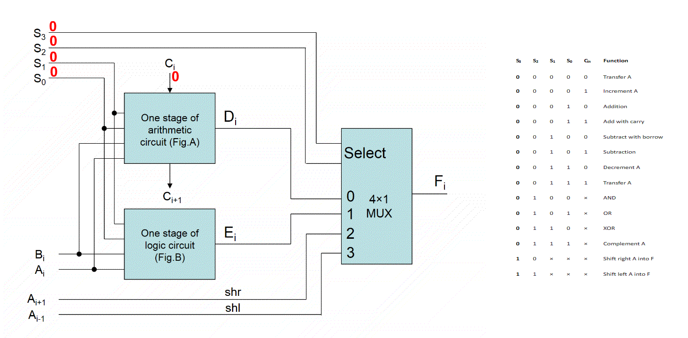

Slide 61
4 - bit Arithmetic Logic Shift Unit
S₃ | S₂ | S₁ | S₀ | C_{in} | Operation | Function
S₃ | S₂ | S₁ | S₀ | C_{in} | Operation | Function
0 | 0 | 0 | 0 | 0 | F = A | Transfer A
0 | 0 | 1 | 1 | 1 | F = A | Transfer A
0 | 0 | 0 | 0 | 1 | F = A + 1 | Increment A
0 | 1 | 0 | 0 | x | F = $A ⋀ B$ | AND
0 | 0 | 0 | 1 | 0 | F = A + B | Addition
0 | 1 | 0 | 1 | x | F = $A∨B$ | OR
0 | 0 | 0 | 1 | 1 | F = A + B + 1 | Add with carry
0 | 1 | 1 | 0 | x | F = A ⊕B | XOR
0 | 0 | 1 | 0 | 0 | F = A + B’ | Subtract with borrow
0 | 1 | 1 | 1 | x | F = A’ | Complement A
1 | 0 | x | x | x | F = shr A | Shift right A into F
0 | 0 | 1 | 0 | 1 | F = A + B’ + 1 | Subtraction
1 | 1 | x | x | x | F = shl A | Shift left A into F
0 | 0 | 1 | 1 | 0 | F = A – 1 | Decrement

Slide 62
Thank you


